Slide 1
Chapter 2: Intro to Relational Model

Slide 2

Example of a Relation
attributes
(or columns)
tuples
(or rows)

Slide 3
Attribute Types
The set of allowed values for each attribute is called the domain of the attribute
Attribute values are (normally) required to be atomic; that is, indivisible
The special value null is a member of every domain. Indicated that the value is “unknown”
The null value causes complications in the definition of many operations

Slide 4
Relation Schema and Instance
A₁, A₂, …, A_{n} are attributes
R = (A₁, A₂, …, A_{n} ) is a relation schema
Example:
instructor = (ID, name, dept_name, salary)
Formally, given sets D₁, D₂, …. D_{n} a relation r is a subset of
D₁ x D₂ x … x D_{n}
Thus, a relation is a set of n-tuples (a₁, a₂, …, a_{n}) where each a_{i} ∈ D_{i}
The current values (relation instance) of a relation are specified by a table
An element t of r is a tuple, represented by a row in a table

Slide 5

Relations are Unordered
Order of tuples is irrelevant (tuples may be stored in an arbitrary order)
Example: instructor relation with unordered tuples

Slide 6

Schema Diagram for University Database

Slide 7

Select Operation – selection of rows (tuples)
Relation r
σ_{(A=B) ^ (D > 5)} (r)

Slide 8
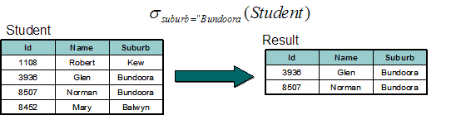
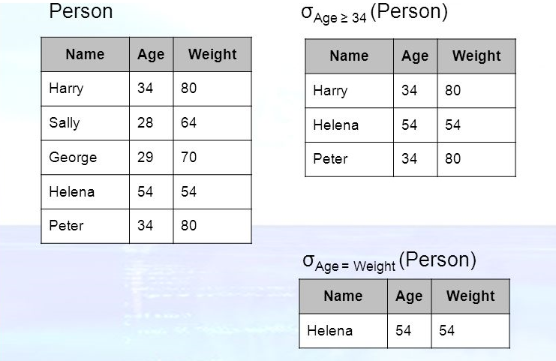
Select Operation – selection of rows (tuples)
Retrieve the Id, Name, Suburb of students who live in Bundoora
Retrieve Name, Age, Weight from the Person Table whose Weight is more than 34?
Retrieve Name, Age, Weight from the Person Table whose Weight is same as Age?

Slide 9
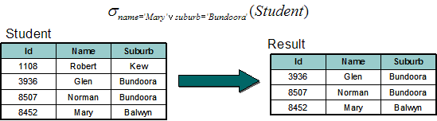
Select Operation – selection of rows (tuples)
Retrieve the Id, Name, Suburd of student who’s name is Mary or students who live in Bundoora.

Slide 10

Project Operation – selection of columns (Attributes)
Relation r:
∏_{A,C} (r)

Slide 11
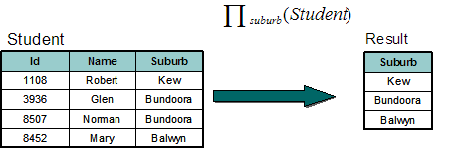
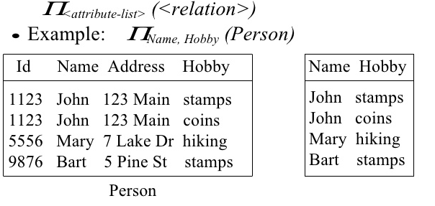
Project Operation – selection of columns (Attributes)
Retrieve the suburbs that are stored in database.
Find Name and Hobby of the Person?

Slide 12

Union of two relations
Relations r, s:
r ∪ s:

Slide 13
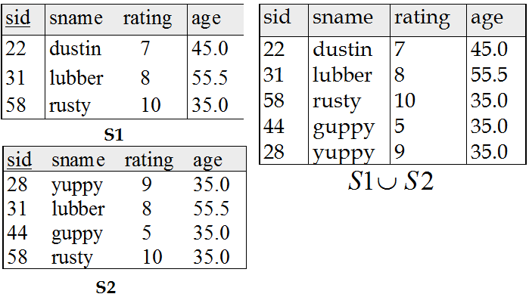
Union of two relations
Two Different Relation has same Attributes, Merge S1 and S2 Relation and List it.

Slide 14
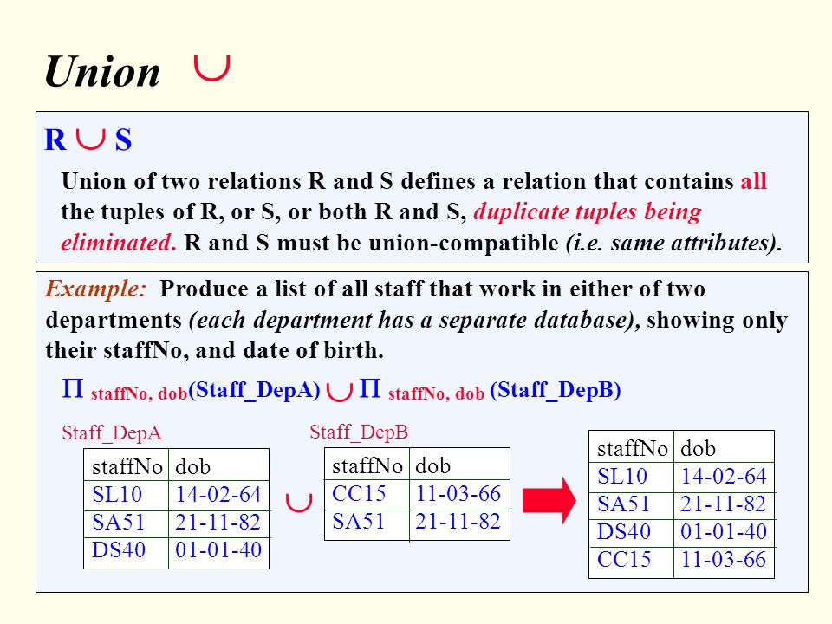
Union of two relations

Slide 15

Set difference of two relations
Relations r, s:
r – s:

Slide 16
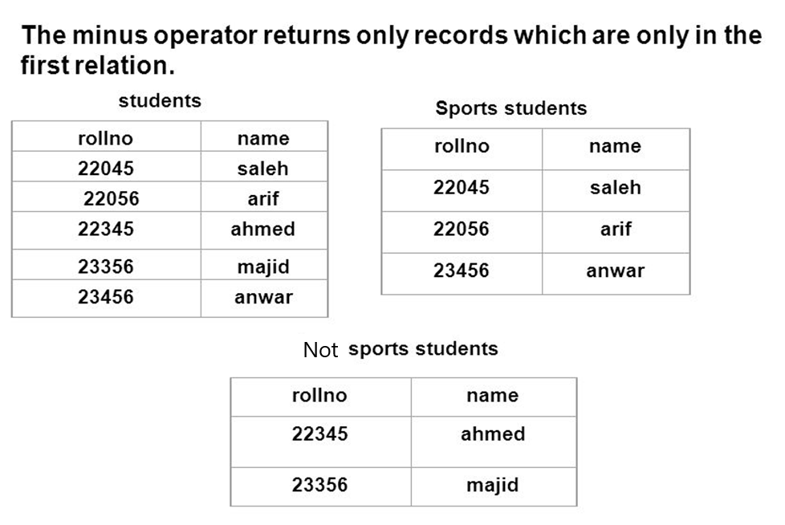
Set Difference of two relations
Find the Students roll no and name, that Who are all not participating in Sports Activity?

Slide 17

Set intersection of two relations
Relation r, s:
r ∩ s
Note: r ∩ s = r – (r – s)

Slide 18
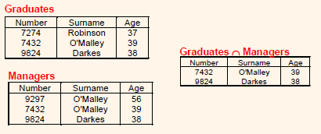
Set Intersection of two relations
Who are all Graduated-Managers?

Slide 19

joining two relations -- Cartesian-product
Relations r, s:
r x s:

Slide 20
Cartesian-product – naming issue
B
Relations r, s:
r.B
s.B
r x s:

Slide 21
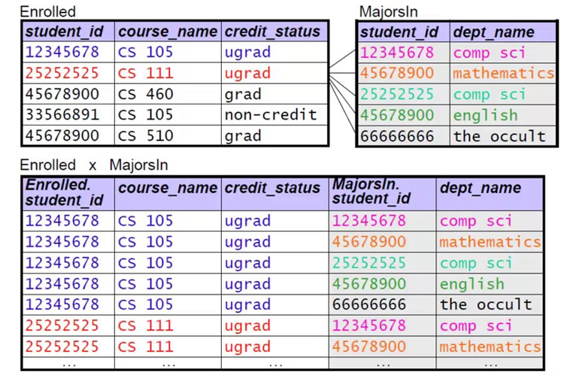
joining two relations -- Cartesian-product
Allot the Subjects to all the students who Enrolled in the Department.

Slide 22
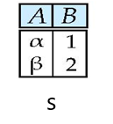
Renaming a Table
Allows us to refer to a relation, (say E) by more than one name.
ρ _{x} (E)
returns the expression E under the name X
Relations r
r.A r.B s.A s.B
r x ρ _{s} (r)
α
α
β
β
1
1
2
2
α
β
α
β
1
2
1
2

Slide 23
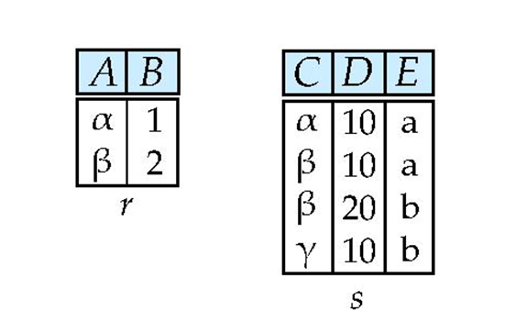

Composition of Operations
Can build expressions using multiple operations
Example: σ_{(A=C)} (r x s)
r x s
σ_{A=C} (r x s)

Slide 24
Summary of Relational Algebra Operators
Symbol (Name) Example of Use
σ
(Selection) ^{σ} salary > = 85000 ^{(instructor)}
Return rows of the input relation that satisfy the predicate.
Π
(Projection) ^{Π} ID, salary ^{(instructor)}
Output specified attributes from all rows of the input relation. Remove duplicate tuples from the output.
x
(Cartesian Product) instructor x department
Output pairs of rows from the two input relations that have the same value on all attributes that have the same name.
∪
(Union) ^{Π} name ^{(instructor) ∪ Π} name ^{(student)}
Output the union of tuples from the two input relations.
-
(Set Difference) ^{Π} name ^{(instructor)} ^{-- Π} name ^{(student)}
Output the set difference of tuples from the two input relations.

